Slide 1



Review Meeting
January 2018

Slide 2
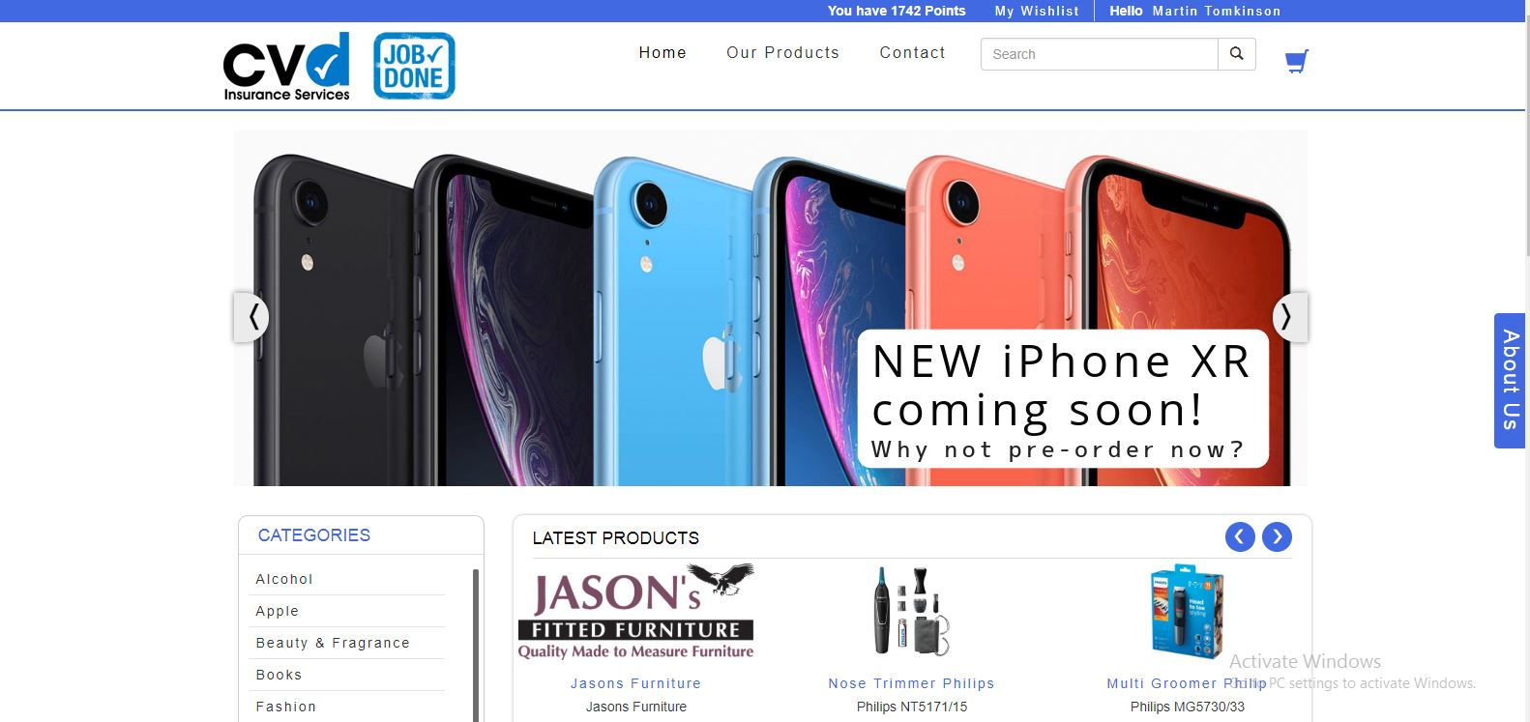
Store

Slide 3
Store Summary

Slide 5
Top Points Holders
FullName | Email | Points | Status | DateAdded
Jaky Pigeon | jack.kilometres88@gmail.com | 1743 | Enabled | 8/18/2016
Jason O'Neill | jason@thebigcoffee.com | 1230 | Enabled | 3/29/2017
Chris Jakeways | chris@vansalesuk.co.uk | 1189 | Enabled | 1/25/2017
Tony Lacey | tonylacey2002@gmail.com | 1090 | Enabled | 4/5/2016
Adrian Teasdale | adrian@tradewindscreens.co.uk | 900 | Enabled | 2/25/2013
Roy Ingleton | ringleton@smguk.co.uk | 790 | Enabled | 11/10/2014
Laine Watts | lwatts@smguk.co.uk | 760 | Enabled | 1/22/2013
Vans Direct | Customer.Care@vansdirect.co.uk | 699 | Enabled | 8/23/2017
John Mullen | edencommercialsltd@hotmail.com | 632 | Enabled | 1/3/2017
Mike Howlin | mikehowlinmotors@btconnect.com | 530 | Enabled | 1/22/2013

